Slide 1
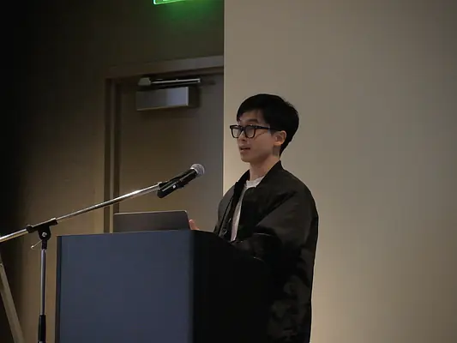
Explicit Folded Reed—Solomon Codes Achieve List-decoding Capacity
Yeyuan Chen
Zihan Zhang

Slide 2
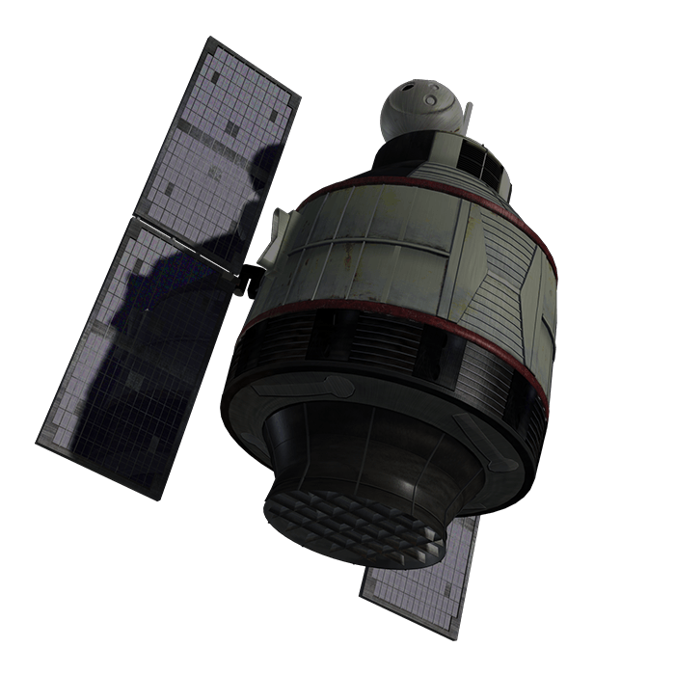
Communication & Coding
Please tell me Who will win the Honors Competition?
Corrupt at most 6 letters
Pleaze tell mi Who vill win the Honers Campetitian?
Future
Present
???
Yeyuan Dong wins the competition.

Slide 3
As long as I repeat each letter for multiple times, the “majority letter” in each block won’t change
WWWWWWWWWWWWWhhhhhhhhhhhhhooooooooooooo
wwwwwwwwwwwwwiiiiiiiiiiiiillllllllllllllllllllllllll
wwwwwwwwwwwwwiiiiiiiiiiiiinnnnnnnnnnnnn
ttttttttttttthhhhhhhhhhhhheeeeeeeeeeeee
cccccccccccccooooooooooooommmmmmmmmmmmmppppppppppppp……
Coding!
Send additional words
Defend against corruptions!

Slide 4
Coding
$k：$#Words you really want to transfer
$d:$ #Additional words
$n=k+d：$ #Actual words you need to send
Decoder
Encoder
Corruptions
$$R=\frac{k}{n}$$
Rate of the code: The higher the better!

Slide 5
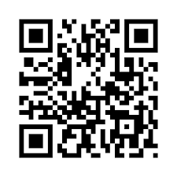
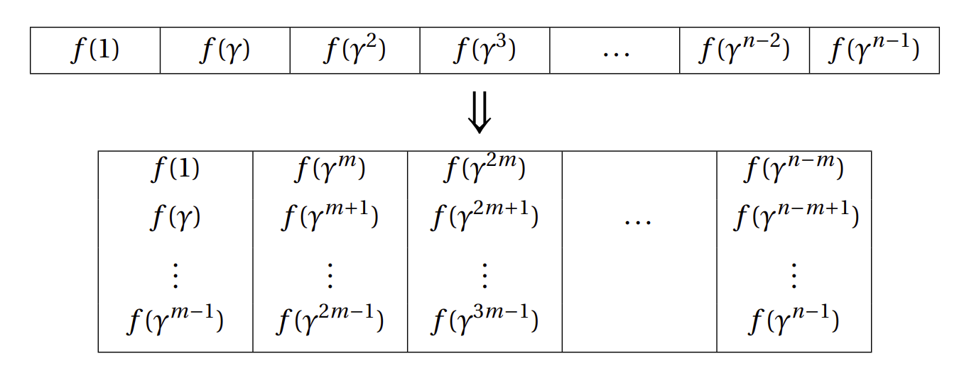
Reed—Solomon Codes
Our results (from a high level): We proved folded Reed—Solomon codes are optimal. It could recover the message from almost $d$ errors, which is the best we could hope.

Slide 6
Unique Decoding
Unique Decoding: Always recover the only original message that could result in the received corrupted sentence.
It’s impossible to perfectly recover the message from more than $\frac{d}{2}$ corruptions!
Singleton Bound
(Singleton’64)
Task: Design codes that can almost perfectly recover the message from more than $\frac{d}{2}$ corruptions!

Slide 7
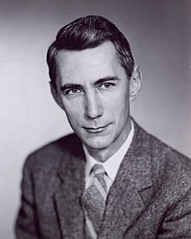
List-decoding
But how??
Explicit constructions and algorithms needed!
The best we could hope
(Elias’91) It’s possible to design codes that can list $\frac{1}{ε}$ candidate messages after $\left(1−ε\right)d$ corruptions, such that the original message must be one of the candidates!
A possible candidate list:
Theory lab won the honors competition before.
Six people share the first place
A paper accepted by STOC2025 proved P=NP
Fundings for mathematicians were taken away by OpenAI o114514.
Winner is the one you would vote for.
Singleton Bound
(Singleton’64)
Good enough in practice!
Claude Shannon
Michigan (BS,BSE)
MIT (MS,PhD)

Slide 8
Explicit Construction
(Elias’91) It’s possible to design codes that can list $\frac{1}{ε}$ candidate messages after $\left(1−ε\right)d$ corruptions, such that the original message must be one of the candidates!
We can
list size $L<poly(n)$ (Rudra-Guruswami STOC06)
The first construction that can recover from $\left(1−ε\right)d$ corruptions
list size $L<{(\frac{1}{ε})}^{\frac{4}{ε}}$ (Kopparty et.al FOCS18)
Folded Reed—Solomon Codes
This construction only needs to list constant number of candidates to recover from $\left(1−ε\right)d$ corruptions
list size $L<\frac{1}{ε}$ (Chen-Zhang 2024)
This construction is the first explicit one provably to be optimal, is the best one we could hope.

Slide 9
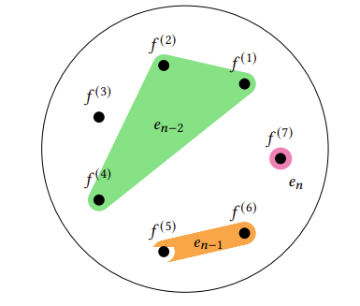
Techniques
Geometric Agreement Hypergraph
12 / 22

